Slide 1

Seizure of Digital Information
Dr. Iftikhar Alam
Associate Professor
CUSIT

Slide 2
Data Seizure
Computers upwards of hundreds of thousands of pieces of information stored in a digital format,
including operating system files,
program files,
user documents,
and file fragments in drive free space.
While the challenge for the laboratory examiner is to find the relevant data objects on a hard drive or other media, a greater challenge exists for the on-scene responders and investigators:
How can the information be collected from the scene and brought to a location where it can be examined?
Does all the hardware on-scene need to be seized as evidence, or will an exact copy of the information serve the purposes of an investigation?
Are there other seizure options to be considered?

Slide 3
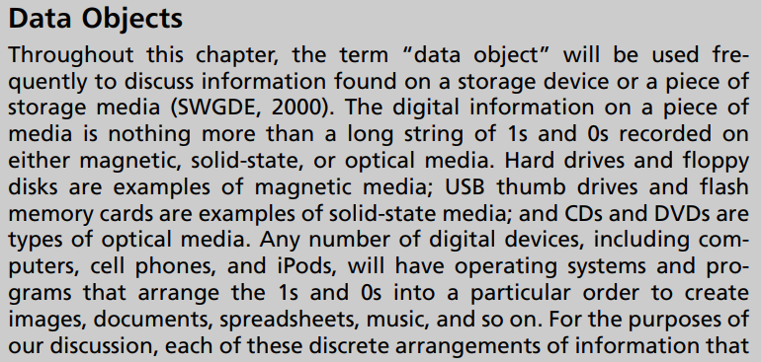
Cont…

Slide 4
Cont…
What we consider to be evidence has a dramatic effect on how we view the electronic crime scene. The current model of digital evidence seizure is focused on physical hardware, which is appropriate in most situations.
However, as we move forward from this point in time, factors such as the size of media and full-disk encryption will impact the ability to seize all the hardware on-scene for later analysis at a forensics laboratory.

Slide 5
Cont…
The community of people that respond to, investigate, and prosecute crimes that have a digital evidence component is a very diverse population with different frames of reference and different technical understanding.
If one group decides to unilaterally implement a change in practices or policy, the ripple effect is felt across the entire system—which is what makes bridging the gaps such an important part of considering and implementing any change resulting from advances in technology.

Slide 6
Defining Digital Evidence
Black’s Law Dictionary—the Bible for legal definitions—provides several definitions for evidence (Nolan, 1990). One of the definitions reads “Testimony, writings, or material objects offered in proof of an alleged fact or proposition.”
Black’s definition of evidence as applied to digital evidence can be viewed.
We can examine the computer itself as the evidence.
This is clearly the case when the computer is the actual instrument of the crime, such as when the physical parts of the computer are used to commit a crime.

Slide 7
Cont…
The computer forensic analysis programs will often use a generic viewer capable of displaying any number of different formats. For example, Access Data’s FTK has a generic format in which all e-mails would be displayed regardless of the program in which they were created.

Slide 8
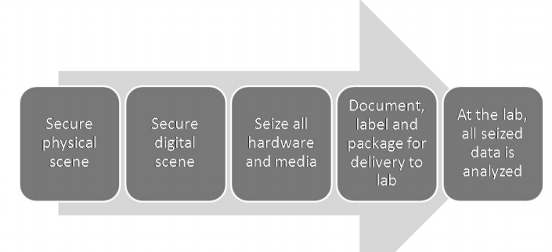
Digital Evidence Seizure Methodology

Slide 9
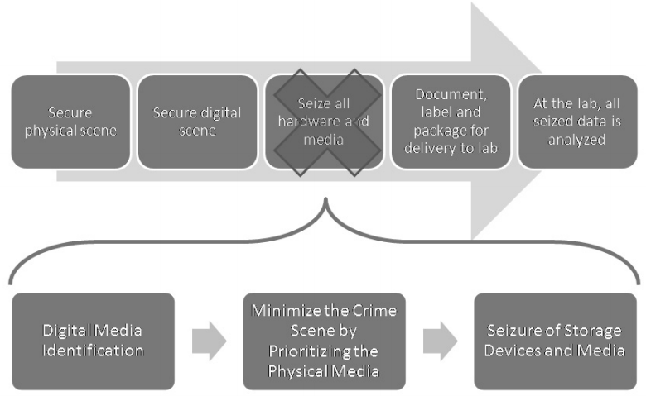
Seizure Methodology in Depth

Slide 10
Step 1: Digital Media Identification
Consider removable media such as flash drives and CDs or DVDs.
Flash drives are often held as personal file cabinets and may contain information of a personal nature.
Look for flash drives on key chains, watches, in cameras, and just about anywhere—
Flash media can be unbelievably small. Another strategy is to look for media that contains backups of files from on-scene computer(s).
If the information is important, you can be sure it will be backed up somewhere.

Slide 11
Step 2: Minimizing the Crime Scene by Prioritizing the Physical Media
Determine which storage devices or pieces of media have the highest probability .

Slide 12
Step 3: Seizure of Storage Devices and Media
After the scene is secured and it is determined that the hardware must be seized, the investigator begins by labeling all the connections/wires attached to the computer.
Labeling of wires and thorough in your documentation. It’s a good practice to label both the end of a cable and place a matching label where the cable connects—for instance, label a Monitor’s VGA Cable B1 and label the computer’s VGA port as B1'; label the monitor’s power cable plug as B2 and label the wall outlet as B2'. Photograph as many relevant objects and seizure steps as you see fit—digital photos are basically free and can be burned to disk and added to the case file.
After the computer has been labeled, documented, and photographed, disassemble the components and prepare the computer case for shipment.

Slide 13
Factors Limiting the Wholesale Seizure of Hardware
Size of Media
Disk Encryption
Disk Encryption

Slide 14
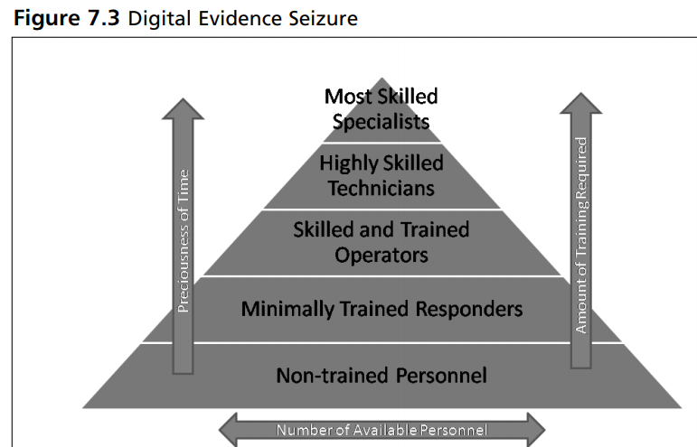
Cont…

Slide 15
Obtaining Information from a Running Computer
If the investigator encounters a computer that is running, and the investigator believes there is information of evidentiary value stored in the computer’s active memory, or RAM, there are options available that allow for the RAM to be recovered.
For example, let’s examine a situation where an investigator shows up on-scene at a location where a suspect has been chatting online with a minor or undercover officer.

Slide 16
Cont…
Chatting is not the only type of data that would be held in RAM. Passwords, unsaved documents, unsaved drafts of emails, IM conversations, and so on could all be held in the RAM, and in no other place on the computer.

Slide 17
Imaging Information On-Scene
Imaging of an entire hard drive on-scene is fairly common among the more technically savvy digital crime scene responders.
Imaging vs Copying

Slide 18
Use of Tools for Digital Evidence Collection
Tools like Autopsy Browser, SMART, iLook, Encase, and Forensic Toolkit are dramatic departures from manual command-line searching and have had a significant impact on the efficiency in which large volumes of data are examined.
These tools have also increased the accessibility of digital evidence to those outside of the closed circle of highly trained forensic examiners.

Slide 19
Assignment
Digital forensics tools for information/data seizure.
End of lecture

